Slide 1
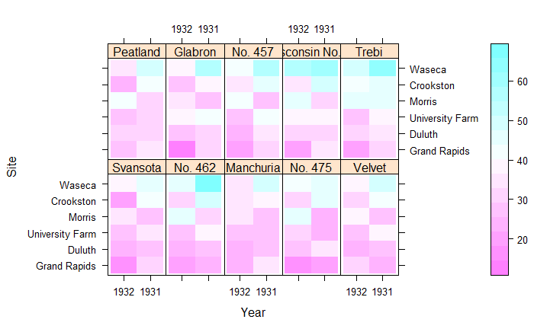
Slide 1: Lattice Graph

Slide 2
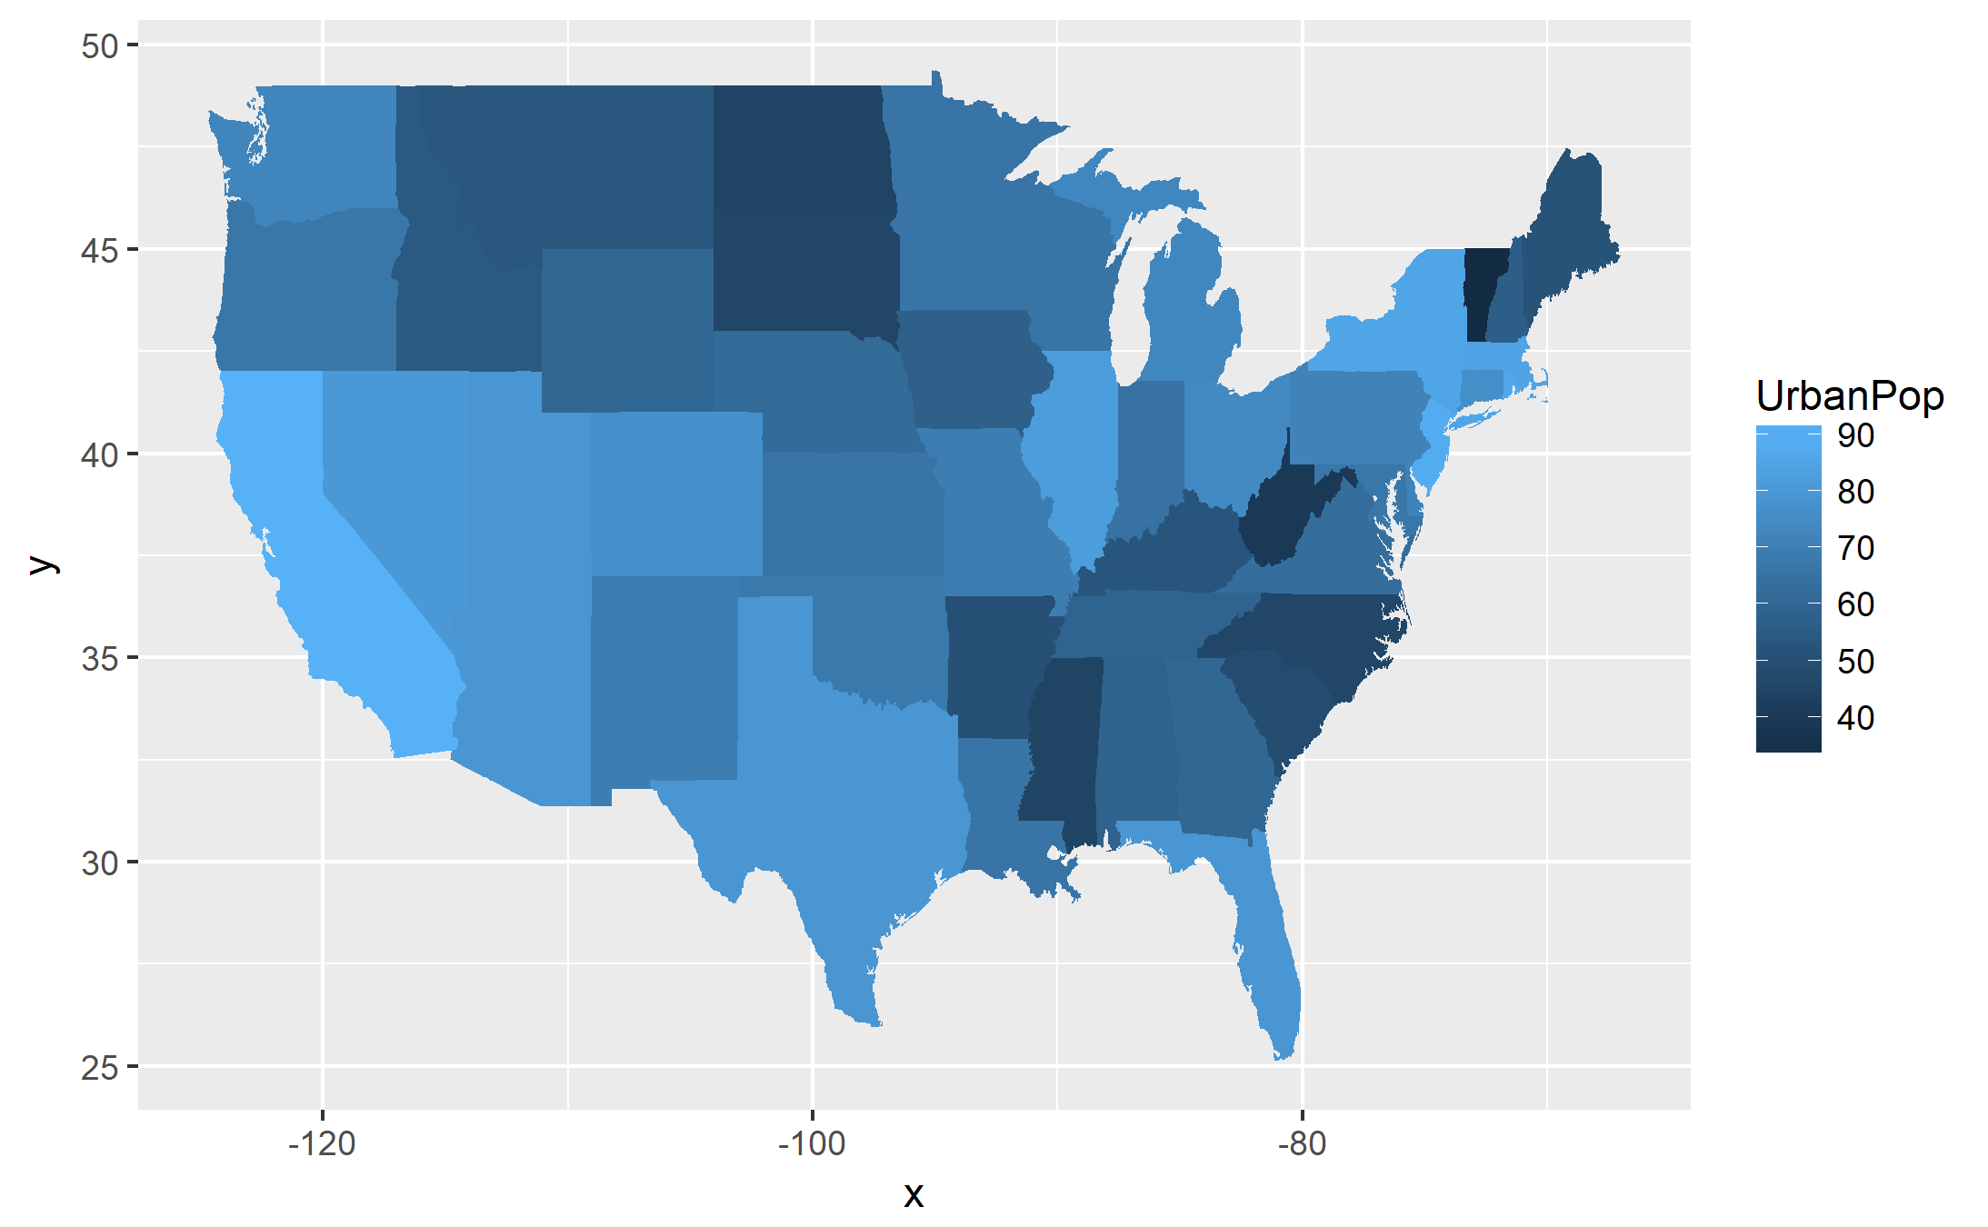
Slide 2: USA Choropleth

Slide 3
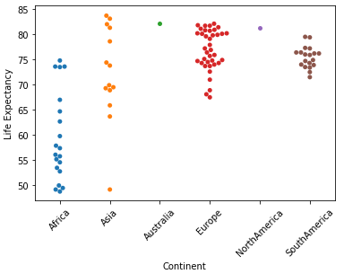
Slide 3: Anaconda

Slide 4
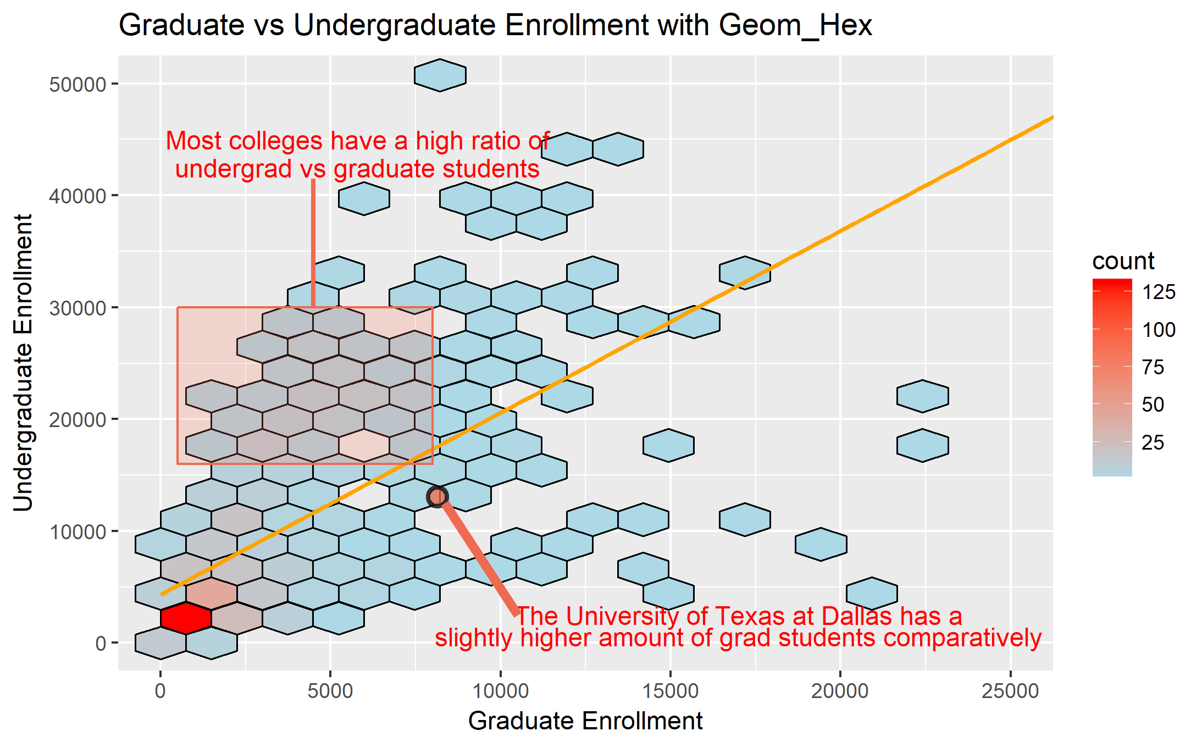
Slide 4: New Geom

